Slide 1
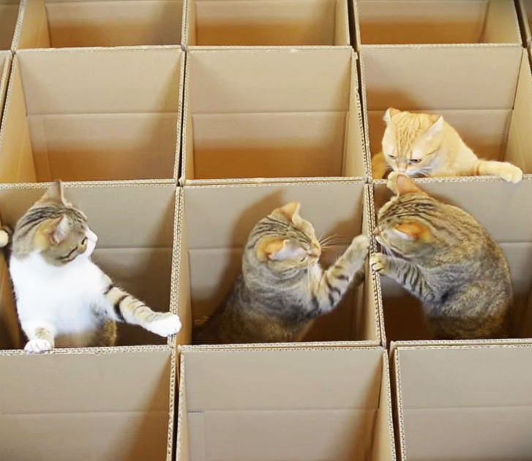
Compartmentalisation Workshop
Ben Laurie, David Chisnall

Slide 2

Reducing blast radius
What breaks if this crashes?
What breaks if this is compromised?
What is leaked in either case?

Slide 3
Trust models for compartments
Sandbox
Things outside are protected
Safebox
Things inside are protected
Mutual Distrust
Protection in both directions

Slide 4
The principle of least privilege
No compartment has rights that it doesn’t need

Slide 5
Library-based compartmentalisation
Each dynamic library is a compartment
Dynamic linker sets up trampolines between cross-compartment calls
Clean up unused registers
Switch the execution stack
Etc.

Slide 6
Demo: Protecting against stack corruption
A pure_computation function is supplied by some untrusted third-party library.
int pure_computation();
This function is supposed to have no side effects, but how do we guarantee that?
The concrete implementation of C implicitly confers many more powerful capabilities to the untrusted function. For example, it could overwrite the stack frame of its caller…

Slide 7
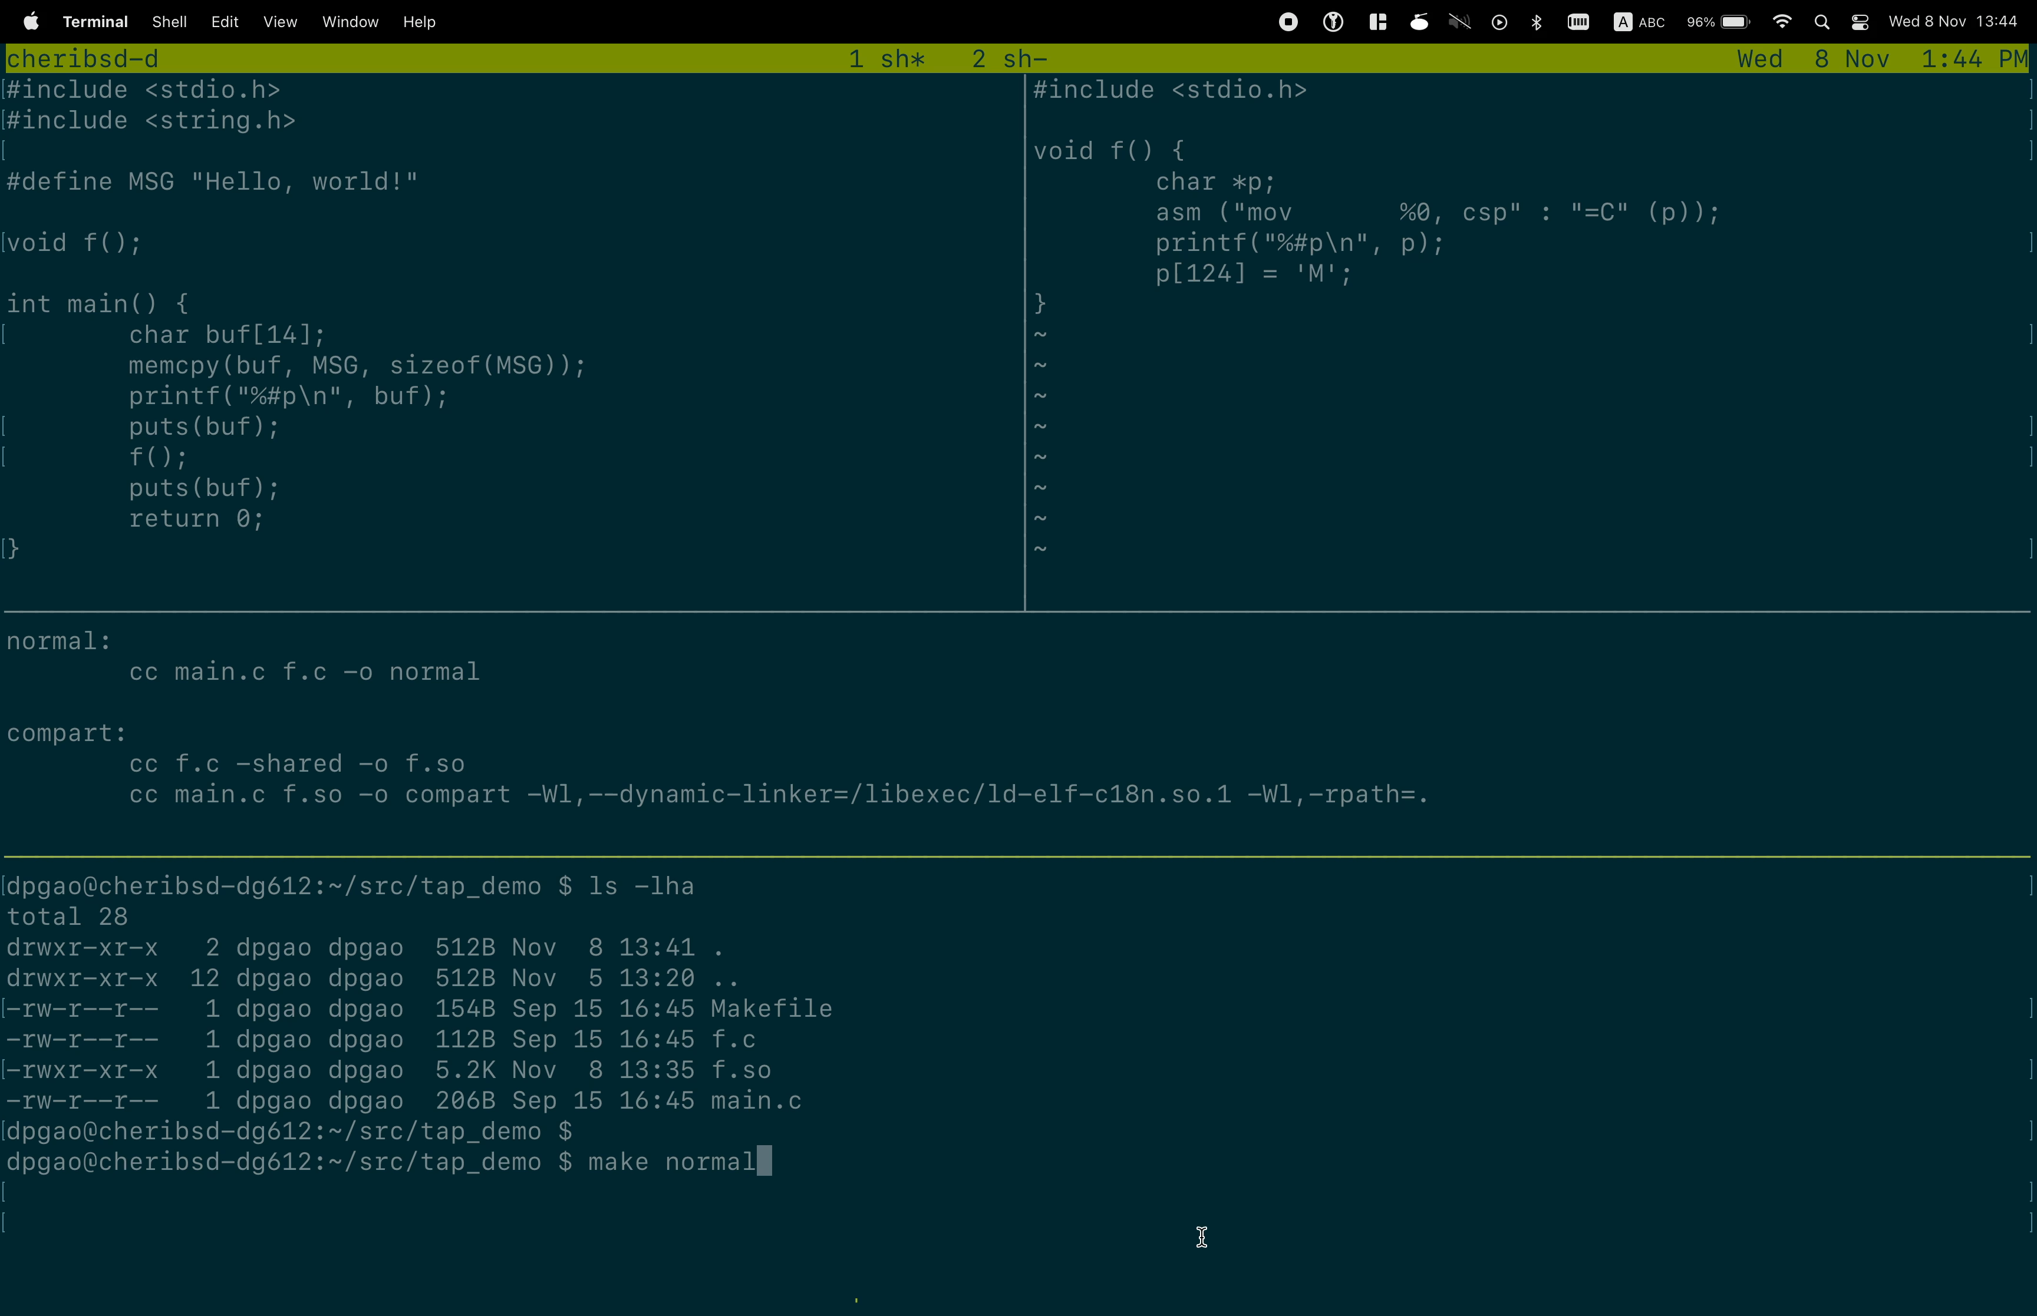

Slide 8
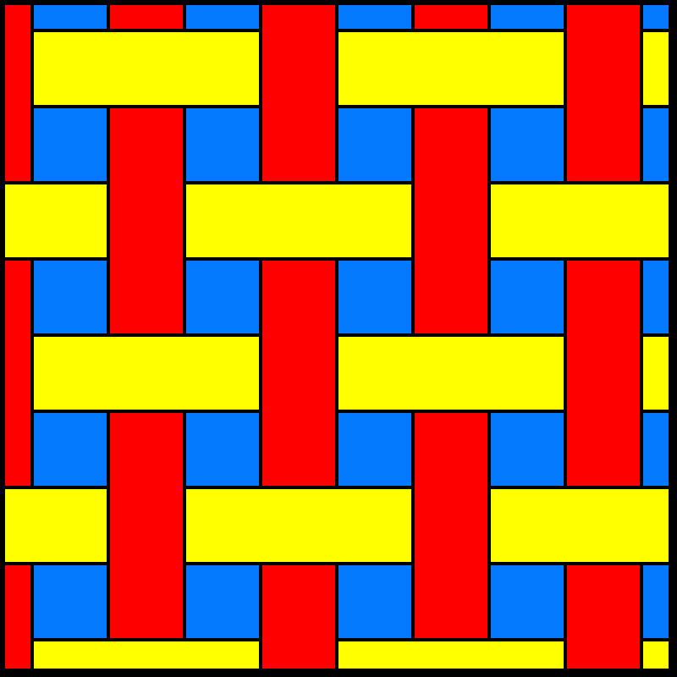
CHERIoT has two-dimensional isolation
Running code can access the current compartment’s state, on behalf of the current thread
Compartments own code and globals
Threads are scheduled independently and call through compartments

Slide 9

Compartmentalisation with CHERIoT
Compartments are invoked as function calls / returns
Safe return is guaranteed by a trusted stack
Callees can access explicit arguments
Callees cannot access any other caller state

Slide 10
Add compartmentalization to C/C++
void
publish(char *key, uint8_t *buffer, size_t size);
// Declaration adds an attribute to indicate
// the compartment containing the implementation
__cheri_compartment("kv_store_sdk")
-- Make sure it’s compiled in the right
-- compartment in xmake.lua
compartment("kv_store_sdk")
add_files("publish.cc")
...

Slide 11
Starting the exercise
https://github.dev/microsoft/cheriot-rtos

Slide 12
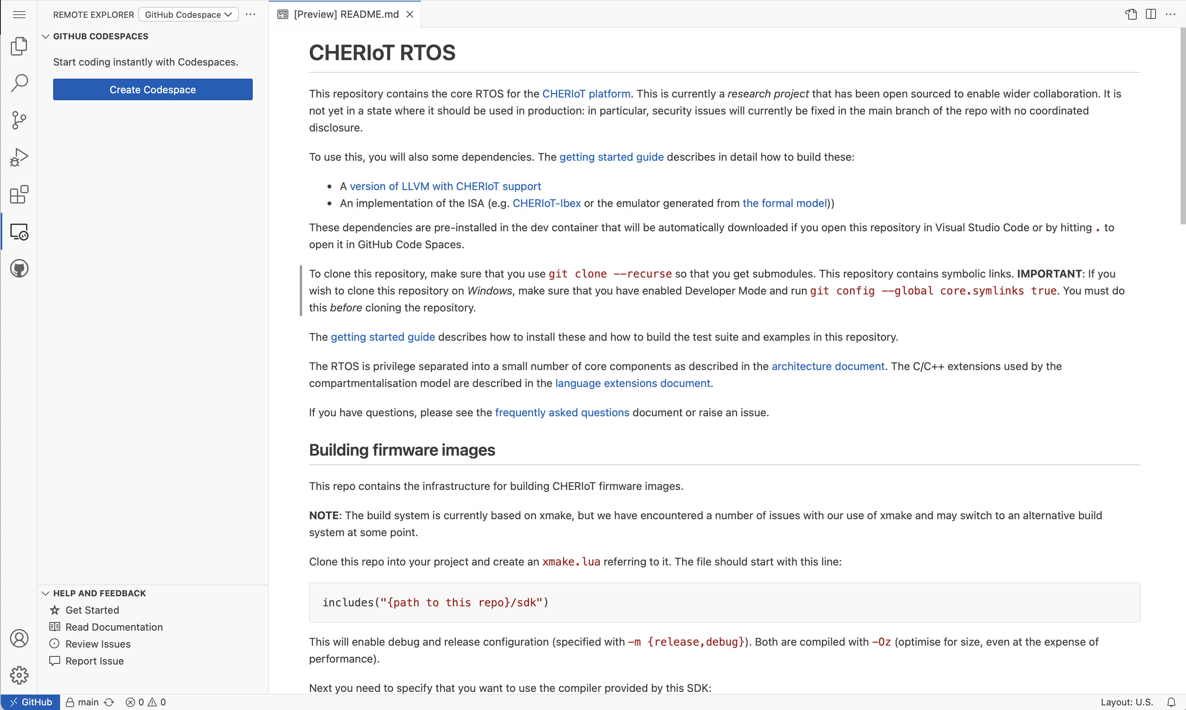
2. Make sure it’s listing code spaces
4. When prompted for code space configuration
Repository:
microsoft/cheriot-rtos
Branch:
main (default branch)
Size:
2 VCPUs
3. Create a code space
1. Click on the Remote Explorer icon

Slide 13
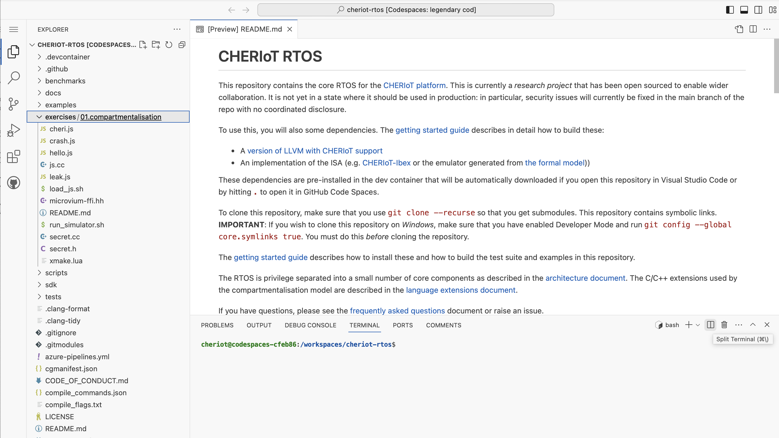
Navigate to the compartmentalisation exercise.
Split the terminal for side-by-side terminals
Read the README!

Slide 14
Run commands in the two terminals
Run the simulator in one terminal
Compile JavaScript and send it to the UART from the other
$ cd exercises/01.compartmentalisation
$ xmake f --sdk=/cheriot-tools/
...
$ ./run_simulator.sh
...
JavaScript compartment: Secret stored at 0x2004cc8c (v:1 0x2004cc8c-0x2004cc90 l:0x4 o:0x0 p: G RWcgm- -- ---)
JavaScript compartment: Read 0x1ac bytes of bytecode
JavaScript compartment: 0xdf8 bytes of heap available
Hello world
$ cd exercises/01.compartmentalisation
$ ./load_js.sh hello.js
Loading JavaScript:
...
Output generated: /dev/null
428 bytes

Slide 15
The exercise structure
JavaScript code simulates an attacker with arbitrary code execution.
Attacks from JavaScript can:
Leak a secret
Crash the system
Exhaust compartment memory
Each exercise will improve compartmentalisation to prevent one attack.

Slide 16
Three exercises
Move the code that owns the secret into a compartment.
Move the JavaScript interpreter into a compartment.
Prevent crashes from leaking memory in the JavaScript compartment.

